Slide 1

Weather app for precised location using android emulator
31/01/2023
Software Testing –CSA3731
S. Muni Chandra
192011245

Slide 2
Content
Objective
Abstract
Proposed system
Flow chart
Concept map
Test cases
App tools and installation
Implementation testing screenshots
Test case outcomes
conclusion

Slide 3
Objectives
To determine the working of the weather app
To test the outcomes of the weather application

Slide 4
Abstract
Creating a weather app which can fetch weather information in a precised location
Install Android Studio , IntelliJ and Appium Software.
Develop Weather App in Android Studio.
Open Weather App in Emulator.
Give Desired Capabilities in Appium Server.
Get the Java code for Testing.
Paste the code in IntelliJ IDE.
Run the code and Test the Conversions and Parameters.

Slide 5
Proposed system
To develop the weather app using Android studios
Run the application using the Android emulator
Test the weather app for the positive and negative outcomes
Appium Interacts with an application automatically and run tests repeatedly against the various applications in various scenarios

Slide 6
Flow Chart(working process)
Install the android simulator,
Measure the temp for next day
Install Appium software and IntelliJ
Measure the humidity
Develop the weather app using the android studio
Test cases
Measure the temperature
Run the weather app in the emulator
Locate the current location in weather app
Open Appium software

Slide 7
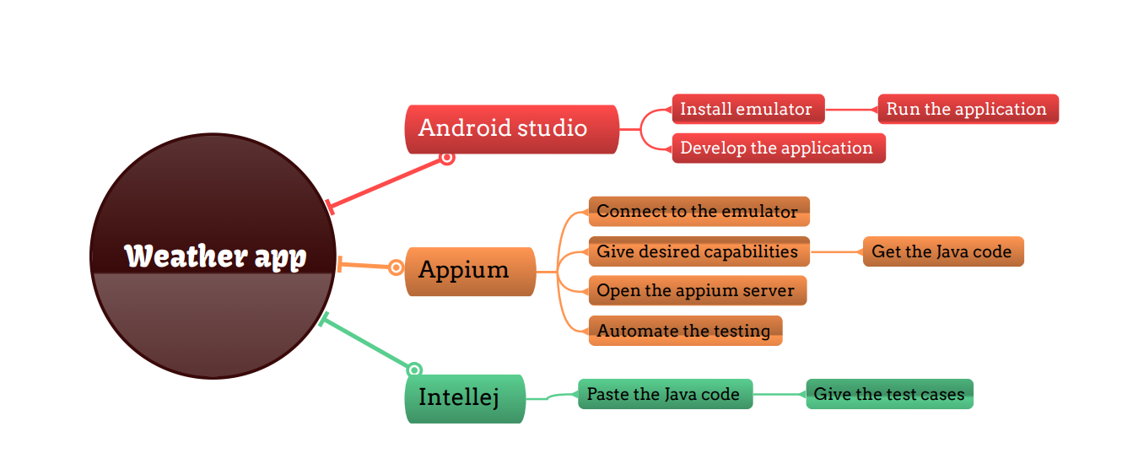
Concept map

Slide 8
Test cases
Checking locations:
Measuring temperature
Measuring the humidity
Measure the fog
Wind speed
Pressure
Performance
Load testing
Security testing
Usability testing
Compatibility testing

Slide 9



Apps tools and installation:
APPIUM
INTELLIJ
ANDROID STUDIO

Slide 10
App tools and installation(cont..)
Appium:
Appium is an open-source automation tool
we can call it an open-source automation framework
It allows us to automate the different type of mobile applications
It could be a web application, it could be a native or hybrid application
It works on Emulator as well as Real device’s

Slide 11
App tools and installation (cont..)
Android studio:
Android Studio is the official integrated development environment (IDE) for Android application development.
It is based on IntelliJ IDEA, a Java integrated development environment for software, and incorporates its code editing and developer tools.
To support application development within the Android operating system, Android Studio uses a Gradle-based build system, emulator, code templates, and Github integration.
Every project in Android Studio has one or more modalities with source code and resource files.

Slide 12
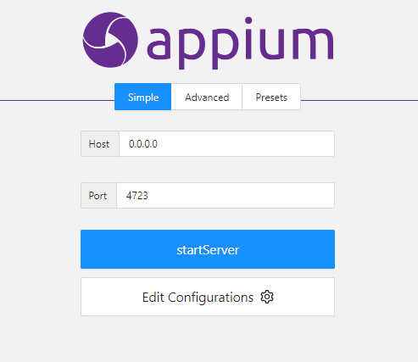
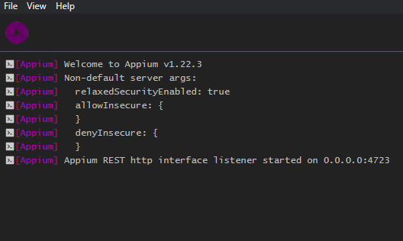
Appium Server
Before starting Server
After starting server

Slide 13
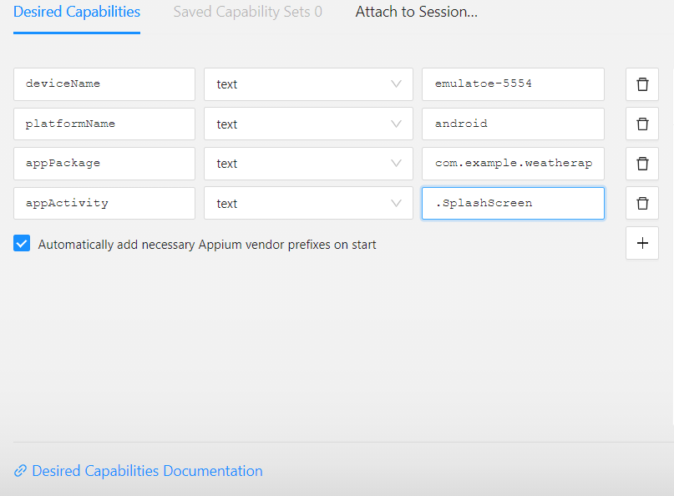
Implementation and testing screenshots
Appium Inspector(Desired capabilities)
Give the Desired Capabilities in Appium Inspector.
It will start the session and gives you java code to start testing.
Paste the code in IntelliJ IDE and Start the Testing.

Slide 14
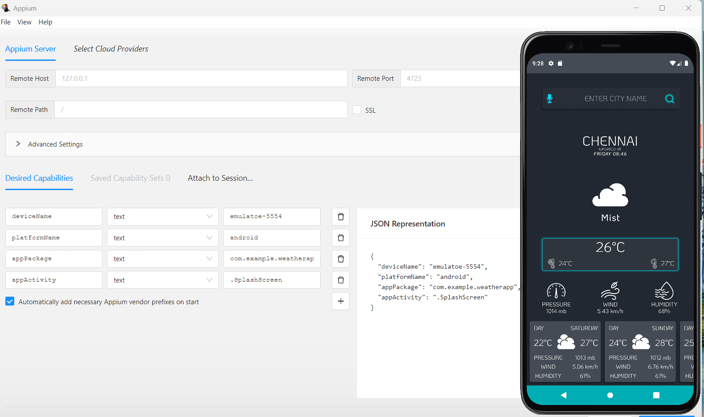
Testing Output

Slide 15
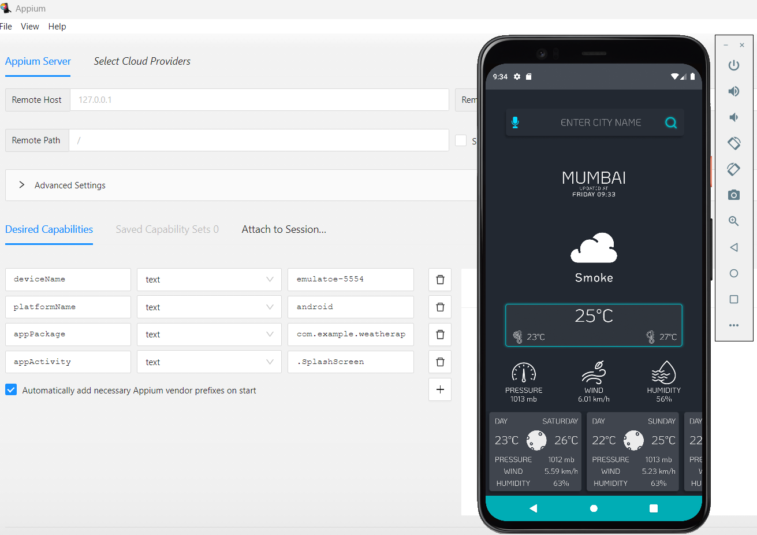
Testing Output

Slide 16
Test Case Outcomes
Test cases | Result
Checking that app displaying accurate Location | Positive
Verifying the Temperature is valid or not | Positive
Verifying the Humidity measure is valid or not | Positive
Verifying the Fog measure is valid or not | Negative
Verifying the Wind speed is accurate or not | Positive
Checking the Device Compatibility (Android 9 or above) | Positive
Verifying the Pressure is valid or not | Positive
Testing the load of the application | Negative
Testing Performance of the application | Negative
Verifying Usability of the application | Positive

Slide 17
Conclusion
Hence the weather app for precised location using android emulator is developed using android studio
Then the weather app is accessed using the emulator
All the possible outcomes and parameters are tested using the Appium server
The Testcases i.e, location , temp, humidity, wind speed, and device compatibility are getting as positive outcomes.
The Test cases i.e,fog , performance and usability are the negative outcomes
70 percent of test cases are regarded as positive outcomes and 30 percent of the test cases are Negative outcomes

